Slide 1
Graduation Project Presentation
Track: Oracle Digital Accounting Specialist
Cash Management Operations and Reporting in Oracle ERP

Slide 2
Prepared By : NEXT20 _ONL1_ERP1_M2d
Ahmed Omar Mohamed Hashem
Ibrahim Mohamed Saber
Esraa Nabil Mohamed
Mohamed Abd El Hafeez Ahmed
Manar Mohamed Ibrahim
Nada Abdulrahman Fikri
Supervisor: ENG. Ahmed Maged
Track: Management and ERP

Slide 3


Goals of the project
The main goals of this project are to provide hands-on experience in managing cash transactions and reporting in Oracle ERP's Cash Management module.
Create and Manage Bank Accounts: Learn how to set up and manage bank accounts in Oracle ERP, ensuring accurate entry of account details.
Record and Manage Cash Transactions: Develop the ability to record manual cash transactions, such as deposits and transfers, and track their impact on cash balances.
Cash Forecasting: Build a basic cash forecasting model to estimate future cash balances based on historical data and adjust forecasts as needed.

Slide 4
Project Description
This project is designed to provide practical experience in managing cash operations and reporting in the Oracle ERP Cash Management module.
Through tasks like bank account setup, cash transactions, bank transfers, forecasting, reconciliation, and cash positioning, the user will learn the entire process of managing an organization's cash flow effectively.

Slide 5
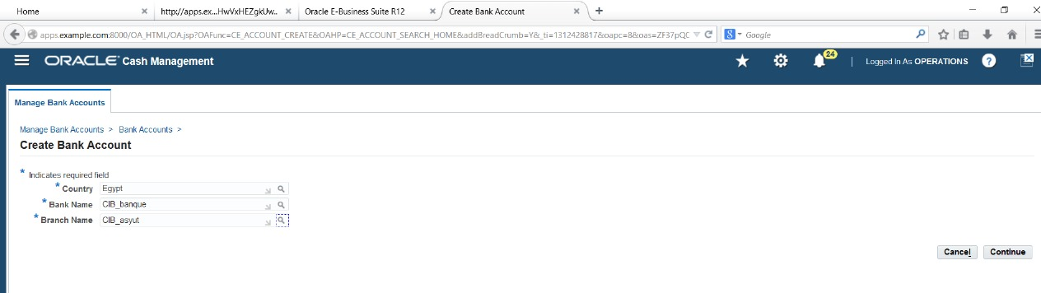
1. Bank Account Create and Management
Learn how to create and manage bank accounts in Oracle ERP
Enter key bank details, including account number, currency, and bank branch information
Creating a New Bank Account:
Navigate to "Bank Accounts" and select "Create" to set up a new bank account.

Slide 6
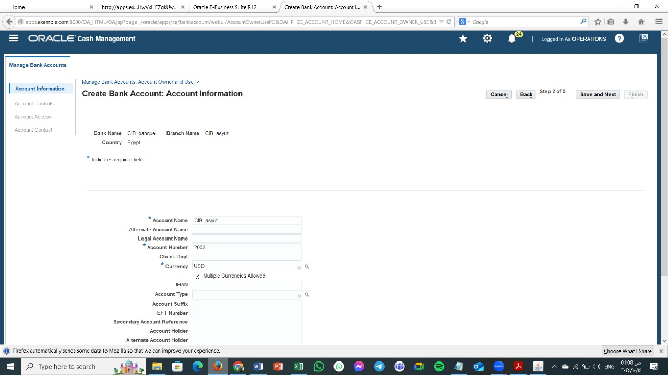
A form will appear where you will enter essential details such as: o Bank Name o Account Number o Currency o Bank Branch Information like the branch code.

Slide 7
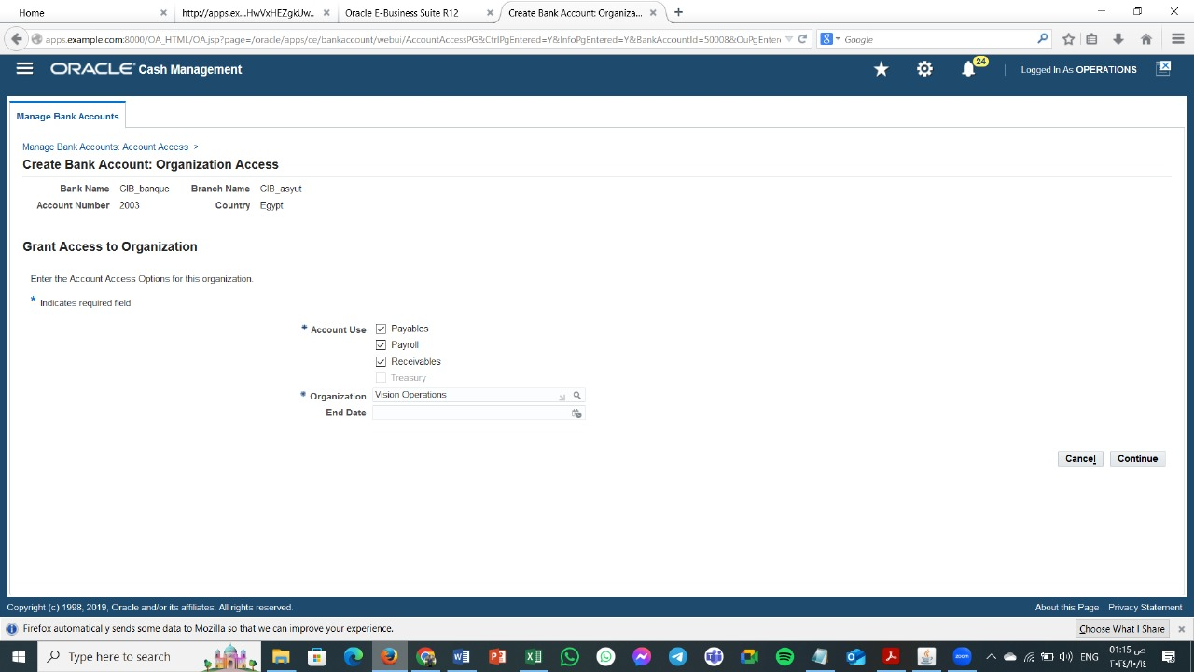
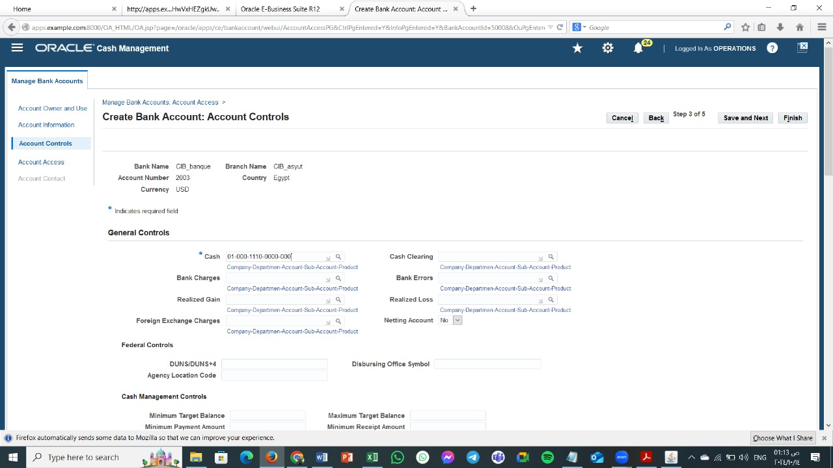
.Saving the Bank Account:
After entering all the required information, click on "Save" to create the new bank account.

Slide 8
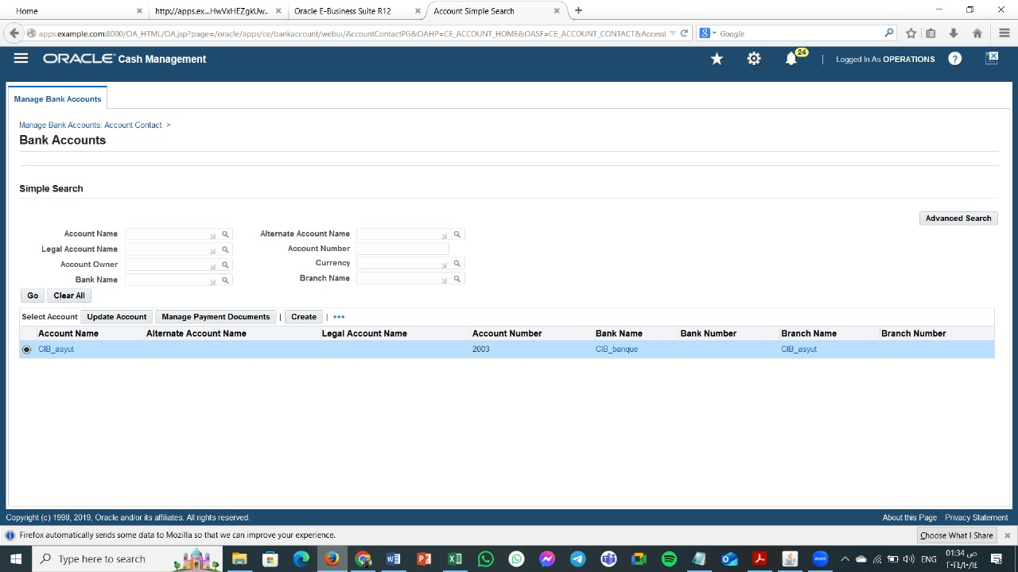

Slide 9
2. Bank Transfers
Process inter-company or inter-bank account transfers.
Track and post cash movement across multiple accounts.
Access the Cash Management Module: Log in to Oracle ERP and navigate to the Cash Management module.
Select the Bank Transfer Transaction Type: Look for a transaction type specifically designed for bank transfers. It might be labeled as "Bank Transfer," "Inter-Bank Transfer," or something similar.
Enter Source and Destination Accounts:
Specify the bank account from which the funds will be transferred (source account).
Select the bank account to which the funds will be sent
(destination account).

Slide 10
4. Input Transfer Amount: Enter the amount to be transferred. 5. Provide Payment Details (if necessary): Depending on your organization's setup, you might need to provide additional details such as: Payment method (e.g., ACH, wire transfer) Payment reference or description Beneficiary information (for international transfers) .screen shots The data of the source bank and the destination bank . The transfer data and amount.

Slide 11
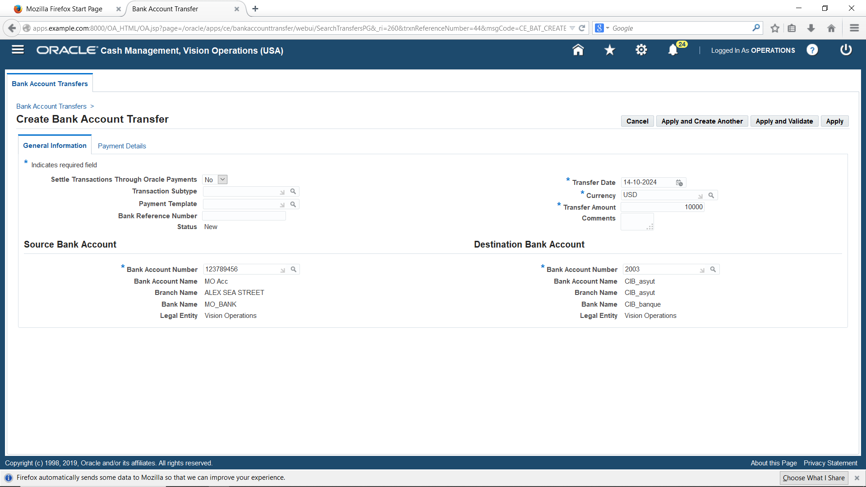

Slide 12
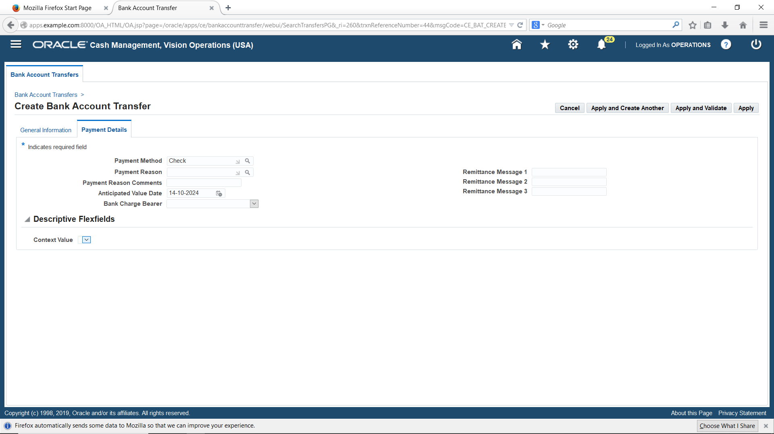

Slide 13
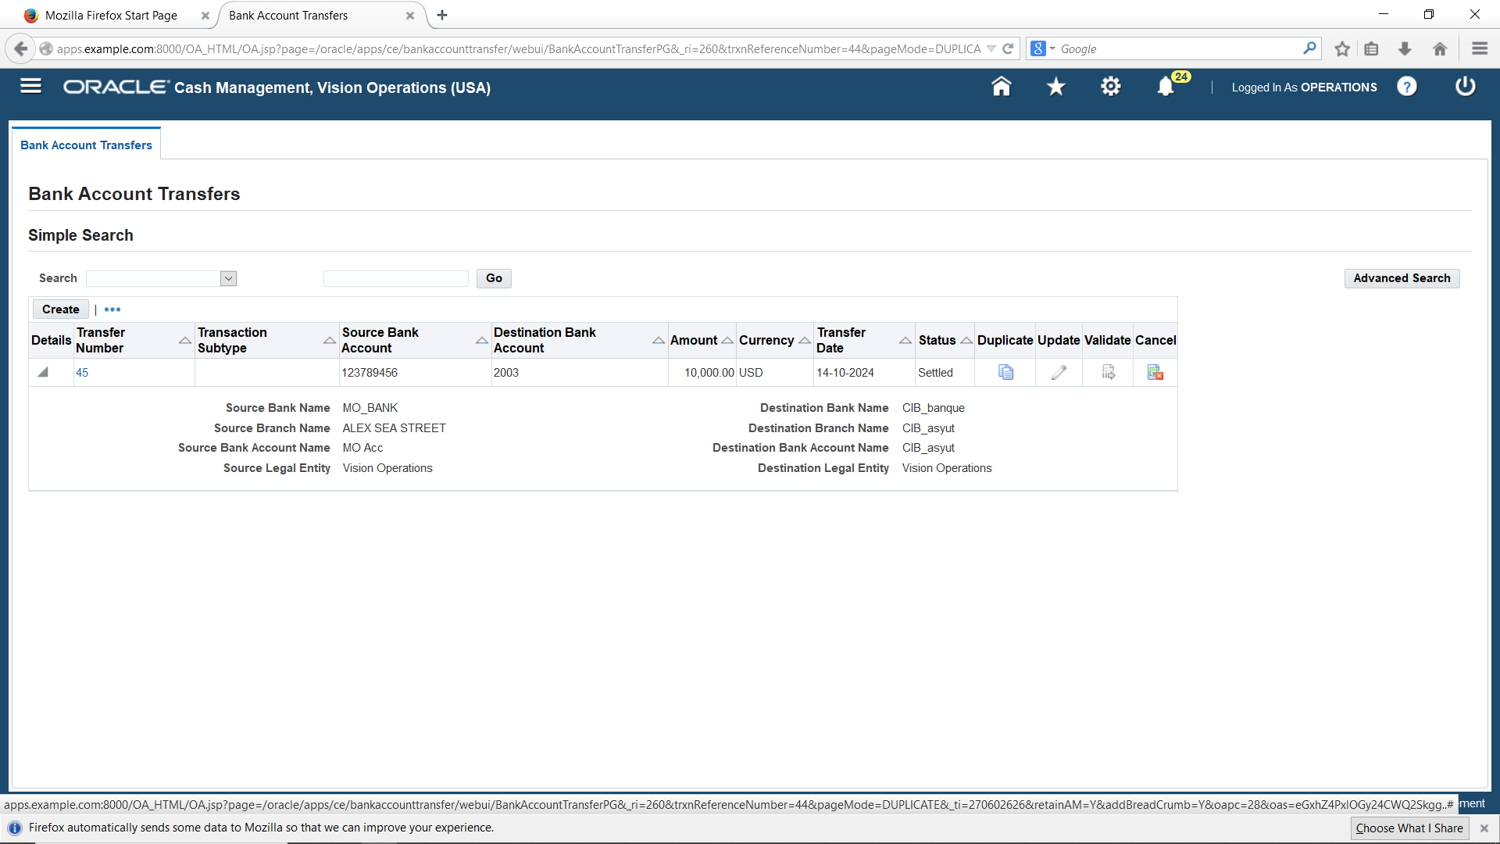

Slide 14
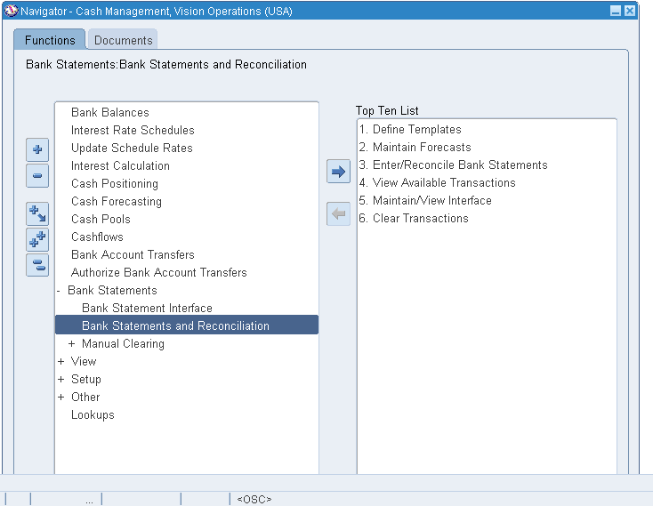
3. Bank Reconciliation
Perform a bank reconciliation to match system records with the bank statement.
Identify discrepancies and adjust system records where necessary.
Bank Reconciliation;
• Creating Bank Reconciliation Statements
1. Payment Reconciliation
Steps:
- Bank Statements-> Bank Statements and Reconciliation

Slide 15
To create a new bank statement line from reconciled transactions:
1. Navigate to the Find Bank Statements window.
2. Enter the query criteria for the statement you want to reconcile, or leave the criteria blank to query all existing statements.
3. Choose Find to see the Reconcile Bank Statements window containing the statements that meet your query criteria.
4. Select the statement you want to reconcile, and choose Review. Optionally, choose New to enter a new bank statement.
5. If you are entering a new bank statement, enter the bank statement header information. If you select an existing bank statement, Cash Management displays the corresponding bank information.
6. Choose Available to search for detail or batch transactions that are available for reconciliation.
7. Enter your search criteria in the Find Transactions window, or leave the criteria blank to search for all available transactions.
8. Choose Find.
9. Select the detail or batch transactions that apply to the bank statement line you want to create.
10. Choose reconcile. Cash Management creates a new bank statement line with an Amount and Type that match the reconciled transaction(s) for that line.

Slide 16
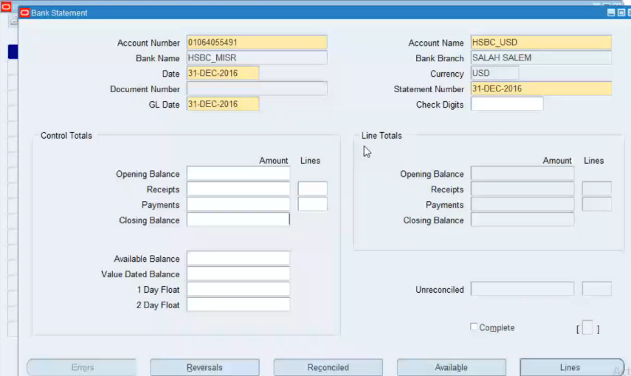
Click on Lines button

Slide 17
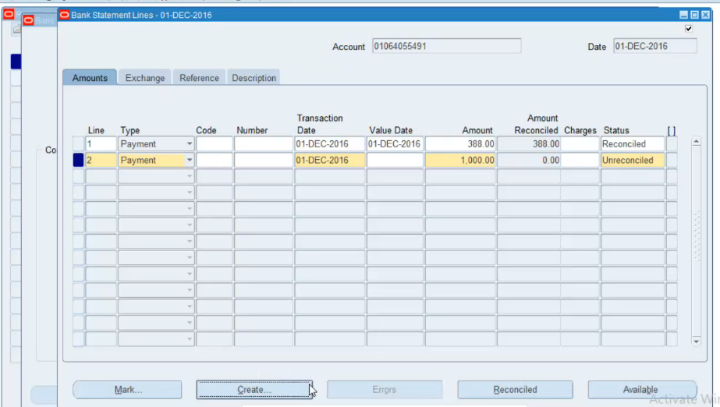
Click on Available button

Slide 18
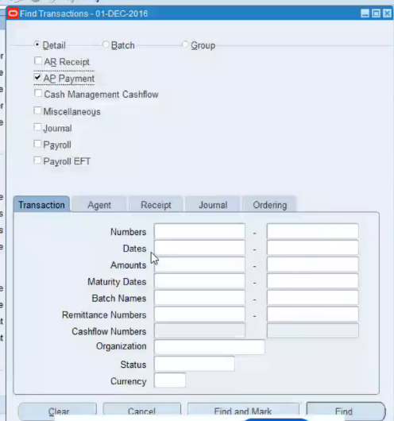
Enable AP Payment and Click on Find button

Slide 19
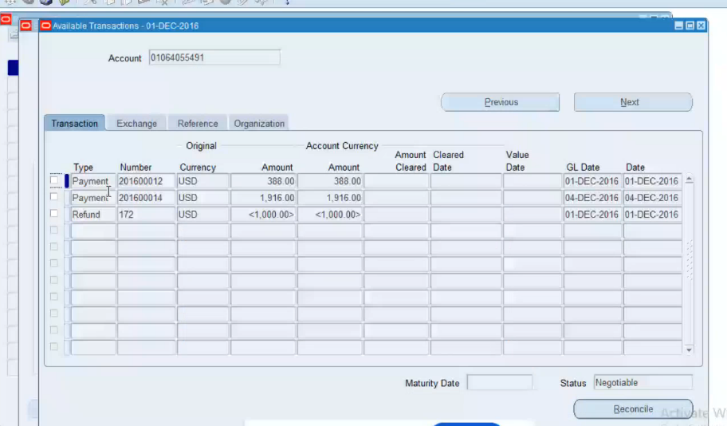
Select the Payment Transaction Document Number ‘201600012’ Check the Status as Negotiable Click on Reconcile button

Slide 20
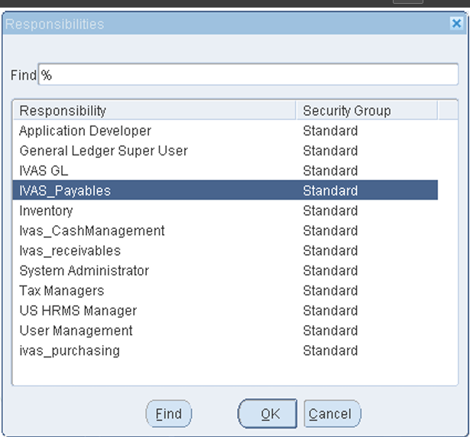
Switch Responsibility: - Ivas_Payables

Slide 21
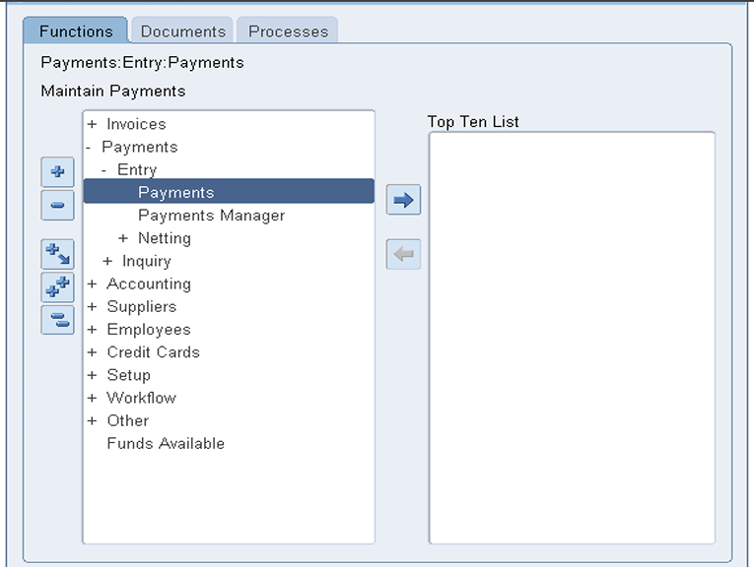
N:- Payments-> Entry-> Payments

Slide 22
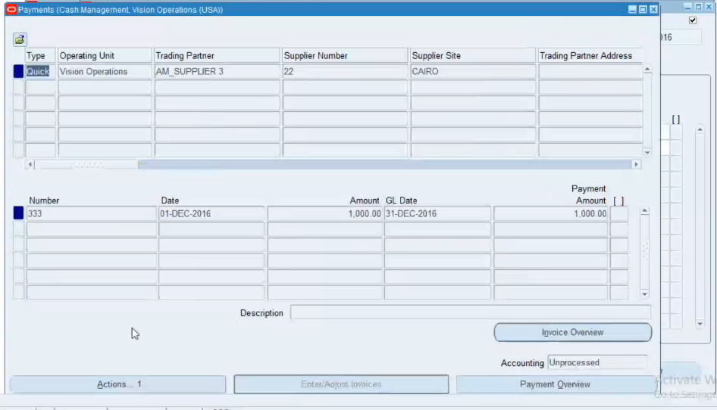
Click on Actions…1 and enable Create Accounting and Final Post

Slide 23
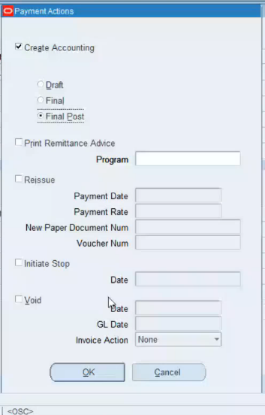
Click on OK button

Slide 24
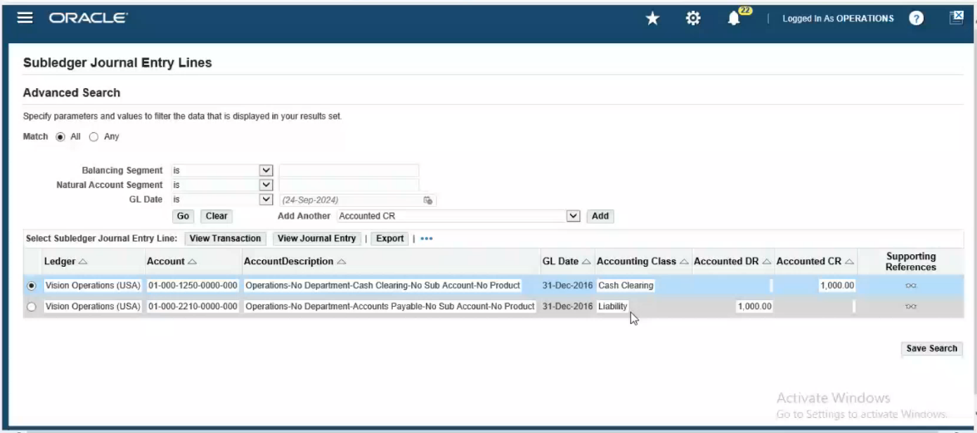
Menu-> Tools-> View Accounting Events

Slide 25
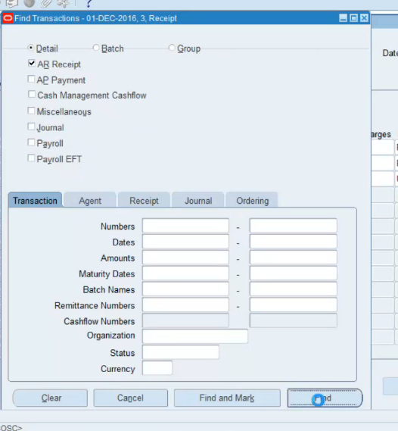
2. Receipt Reconciliation: Same as the previous steps;
Enable AR Receipts and Click on Find button

Slide 26
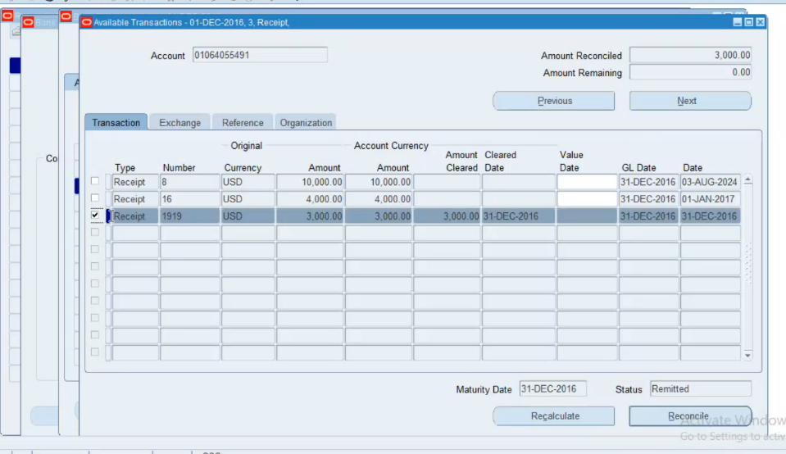
Select the Receipt Transaction Document Number ‘1919’ Check the Status as Remitted Click on Reconcile button

Slide 27
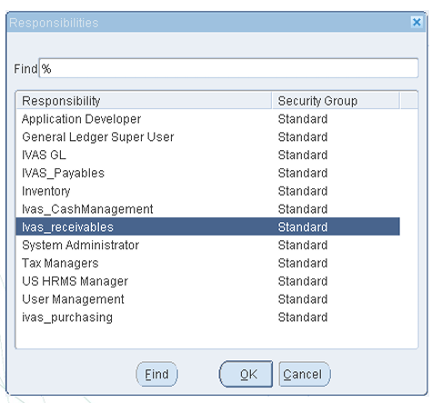
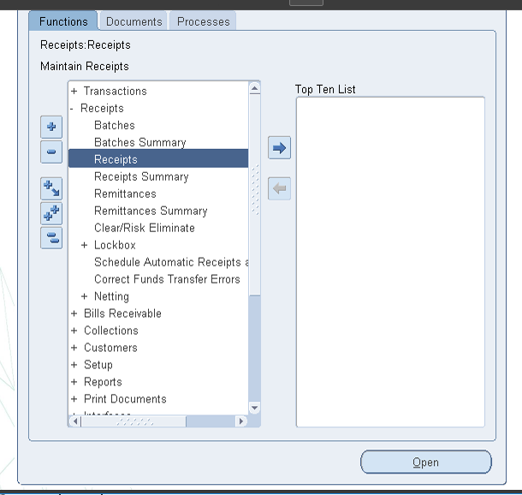
Switch Responsibility:- Ivas_receivables
N:- Receipts-> Receipts

Slide 28
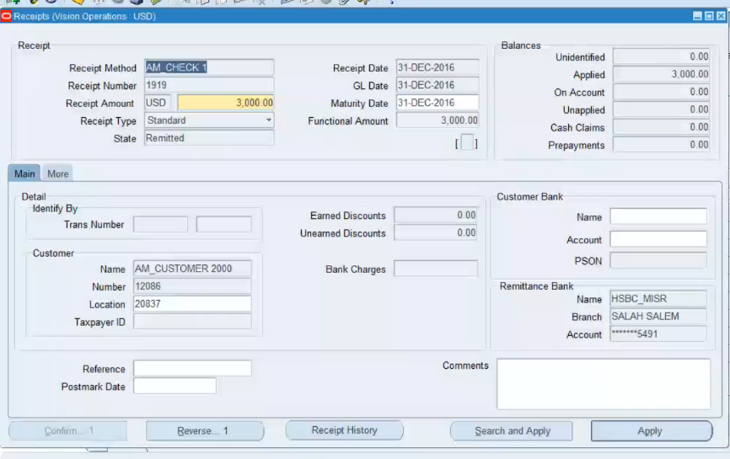
Check the Status changed from Remitted to Cleared

Slide 29
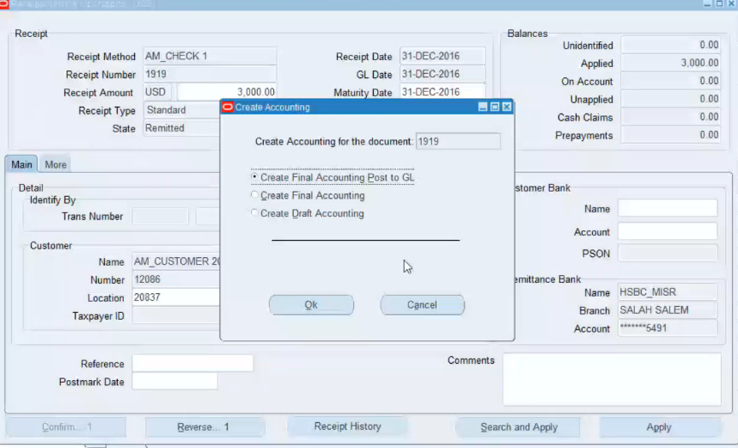
Click on Tools -> Create Accounting-> Create Final Accounting Post to GL

Slide 30
4. Forecast Adjustments
Adjust cash forecasts based on actual bank balances and recent transactions.
Incorporate adjustments to refine future projections.
Cash forecasting is a planning tool that helps you anticipate the flow of cash in and out of your business, allowing you to project your cash needs and evaluate your company's liquidity position.

Slide 31
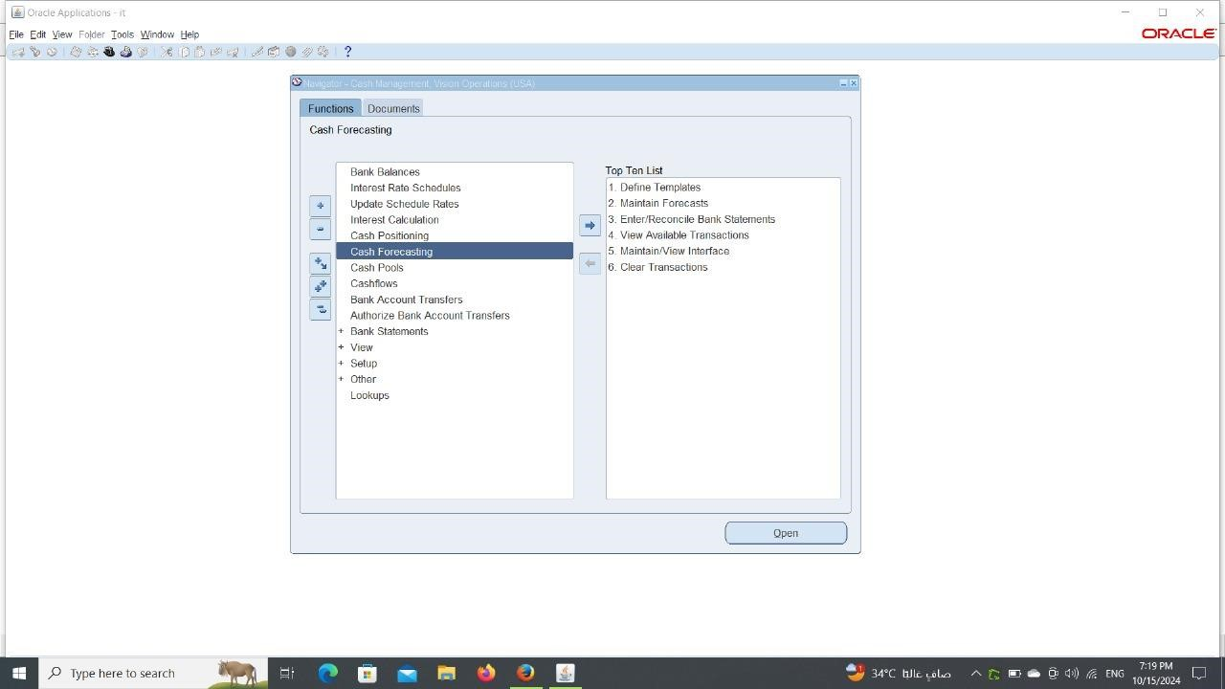
Steps: 1. Log in as User Name: - operations and Password: - Welcome 2. Switch responsibility: - Cash Management, Vision Operations (USA) 3. N: - Cash Forecasting

Slide 32
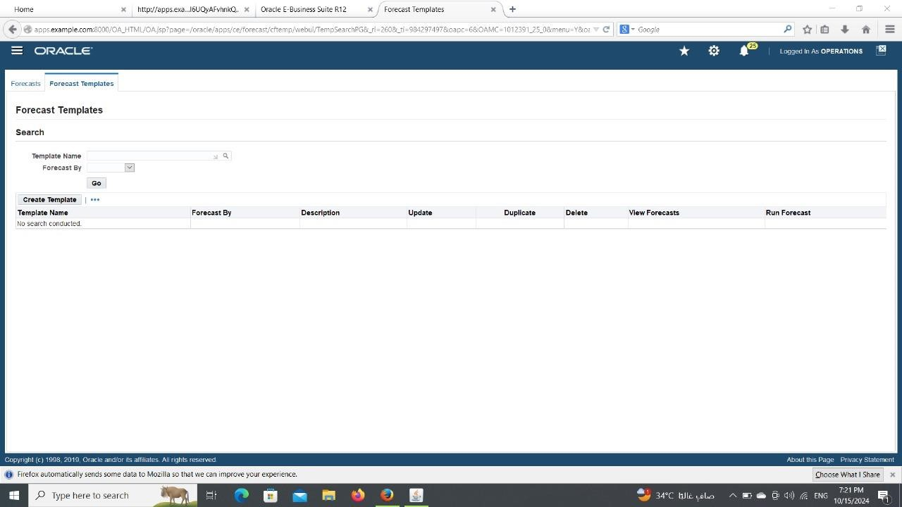
Click on Create Template

Slide 33
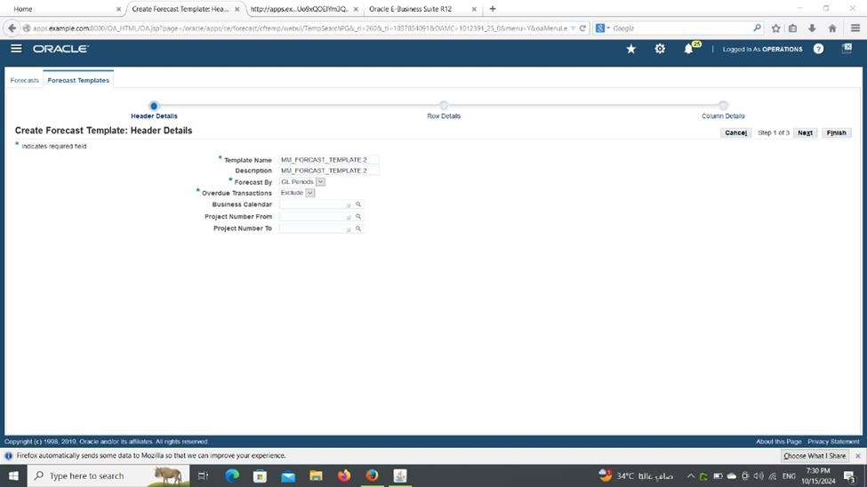
Enter the ‘Template Name’ as ‘MM_forecast_Templete 2’ , ‘Forecast By’ as ‘GL Periods’ and ‘Overdue Transactions’ as ‘Exclude’ then Click on Next Button

Slide 34
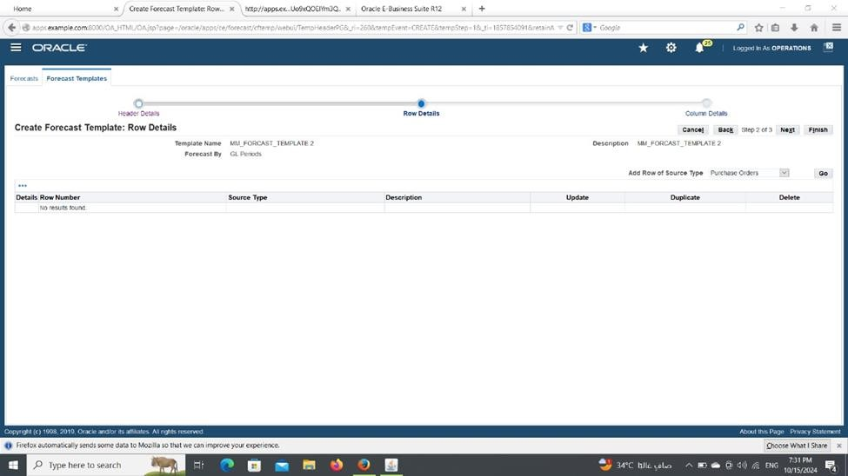
Select ‘Add Row of Source Type’ as ‘Purchase Orders’ then click on GO Button

Slide 35
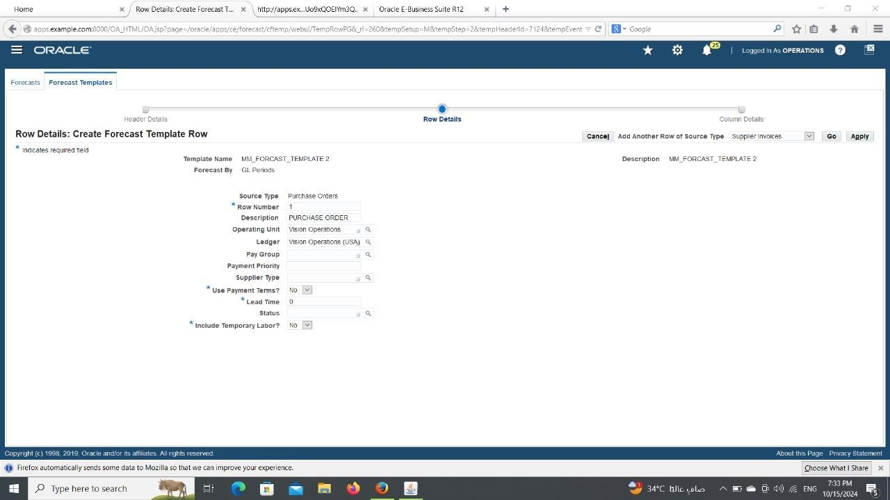
Enter the Row number as 1, Description, Operating Unit as Vision Operations, Leger as Vision Operations (USA), Enter the other required fields then Click on Apply button

Slide 36
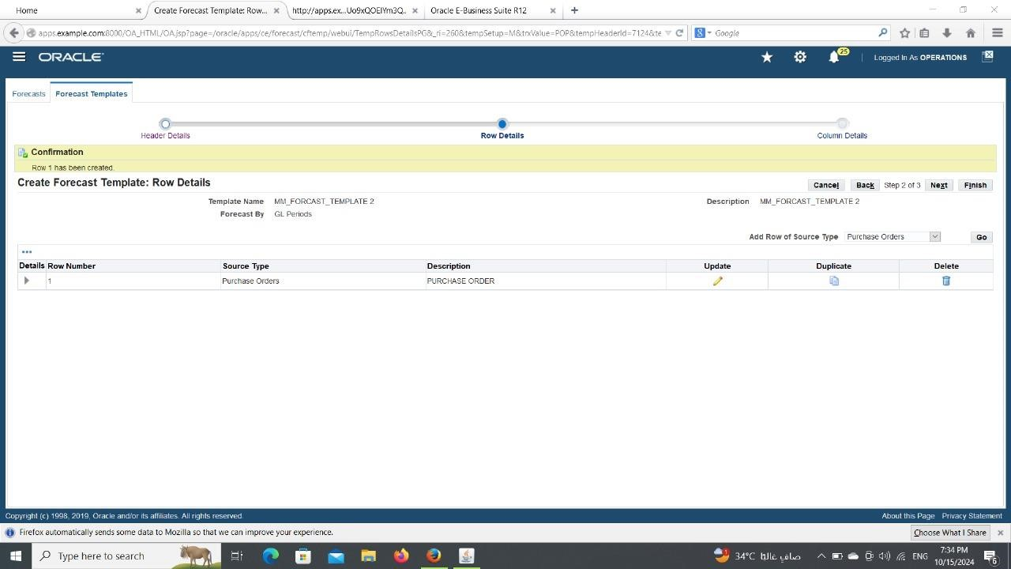
Select Add Row of Source Type as Supplier Invoices then click on GO button

Slide 37

Enter the Row number as 2, Description, Operating Unit as Vision Operations Leger as Vision Operations (USA), Enter the other required fields then Click on Apply button

Slide 38
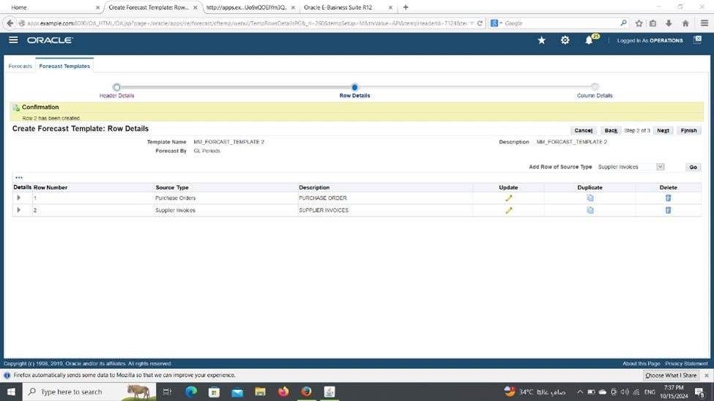
Select Add Row of Source Type as Supplier Payments then click on GO button

Slide 39
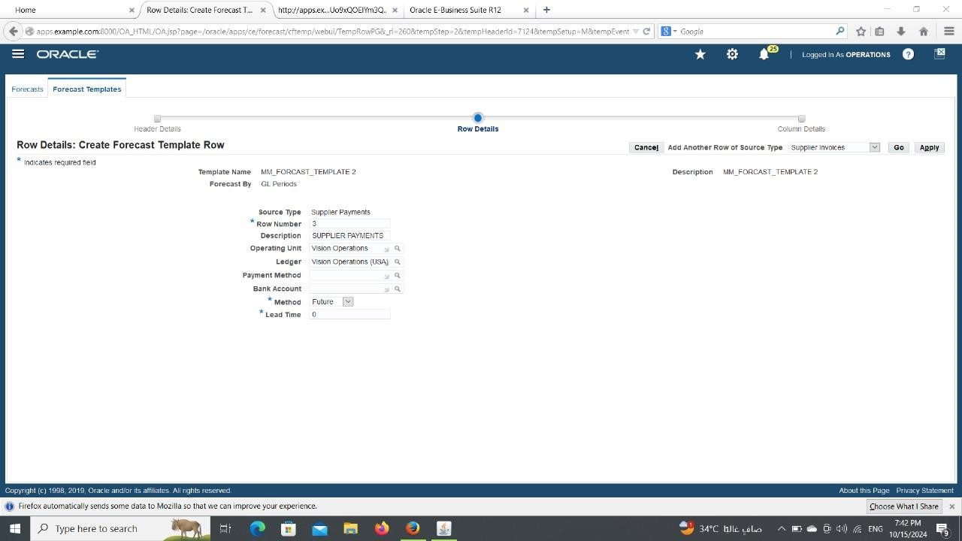
Enter the Row number as 3, Description, Operating Unit as Vision Operations, Leger as Vision Operations (USA), Enter the other required fields then Click on Apply button

Slide 40
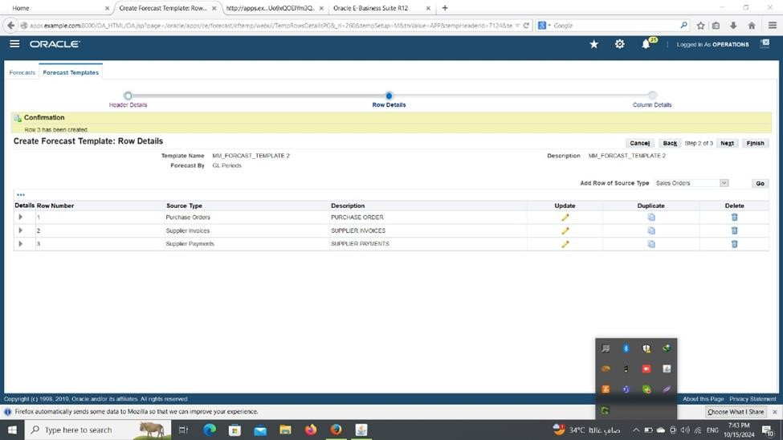
Select Add Row of Source Type as Sales Orders then click on GO button

Slide 41
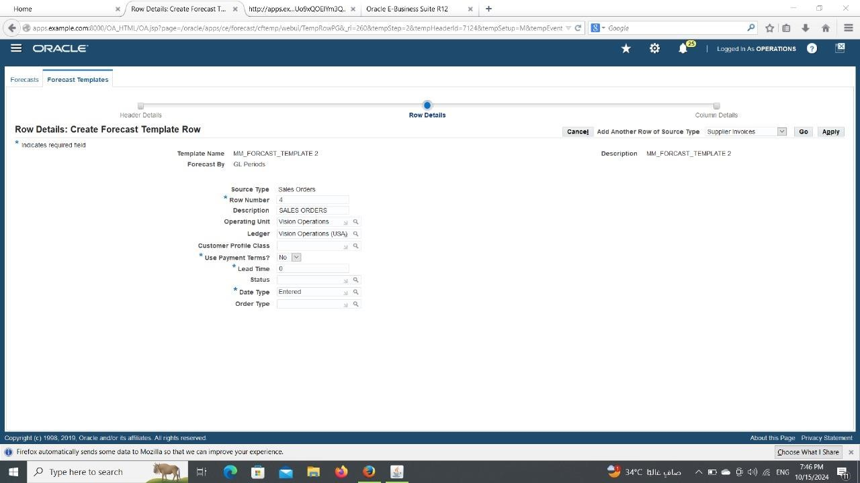
Enter the Row number as 4, Description, Operating Unit as Vision Operations, Leger as Vision Operations (USA), Enter the other required fields then Click on Apply button

Slide 42
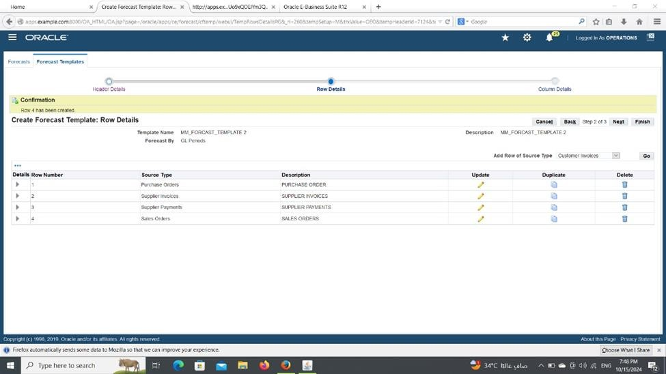
Select Add Row of Source Type as Customer Invoices then click on GO button

Slide 43
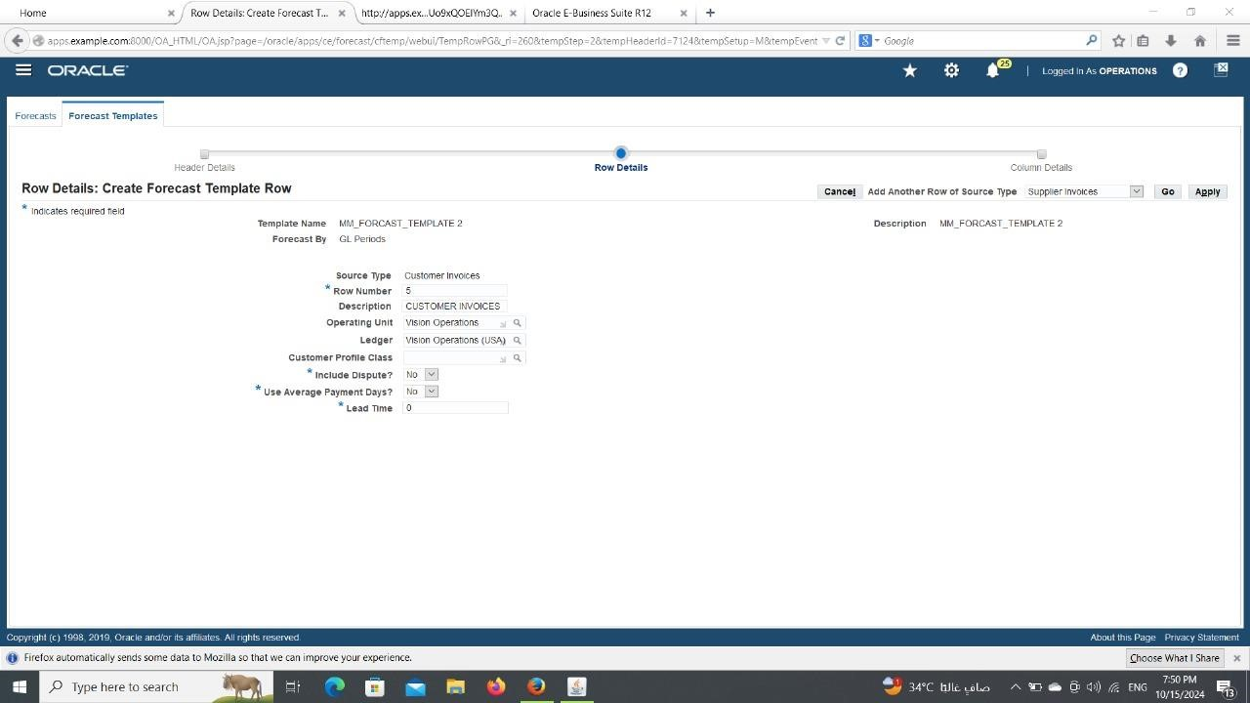
Enter the Row number as 5, Description, Operating Unit as Vision Operations, Leger as Vision Operations (USA), Enter the other required fields then Click Apply button

Slide 44
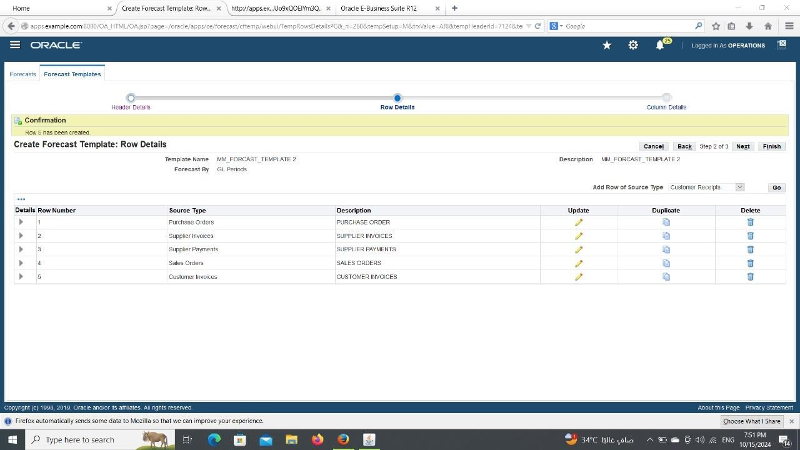
Select Add Row of Source Type as Customer Receipts then click on GO button

Slide 45
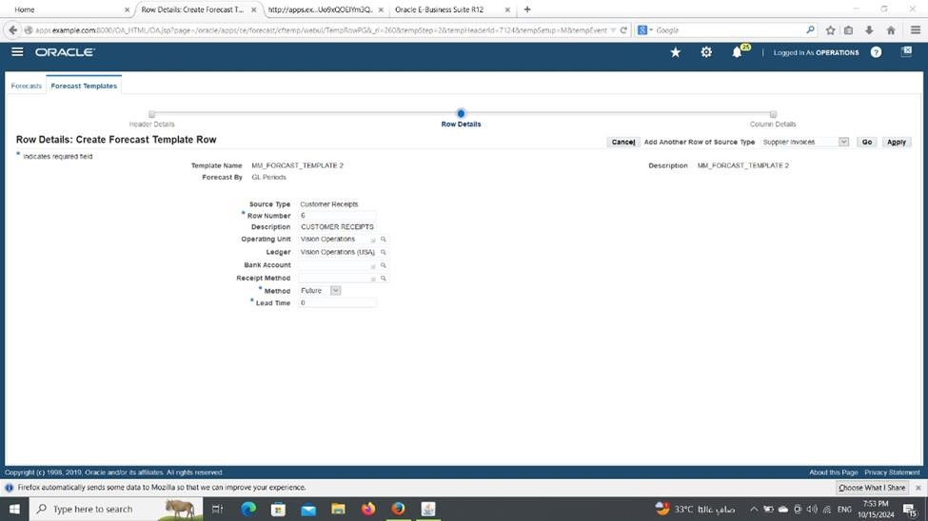
Enter the Row number as 6, Description, Operating Unit as Vision Operations, Leger as Vision Operations (USA), Enter the other required fields then Click on Apply button

Slide 46
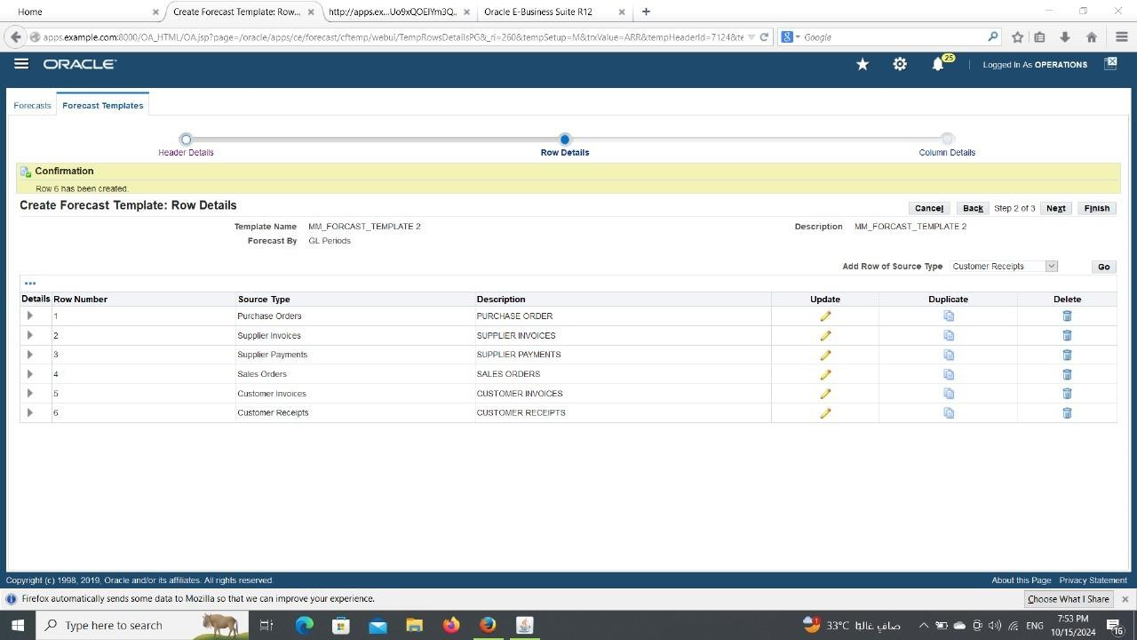
Click on Next

Slide 47
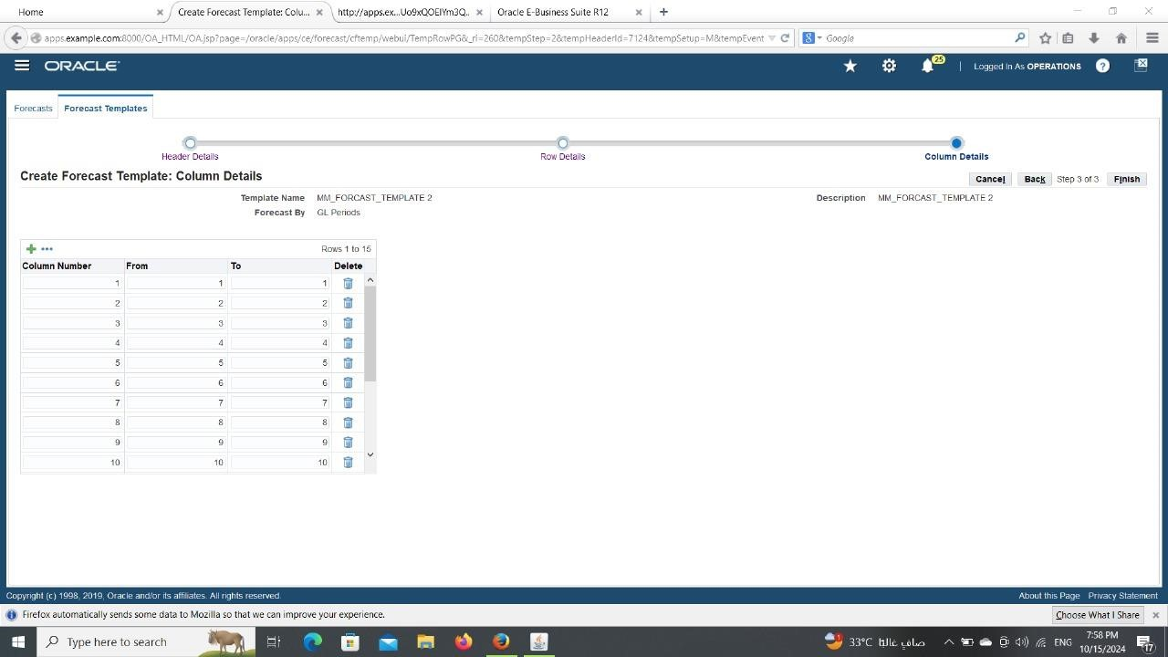
Give the Column Numbers from 1 to 12

Slide 48
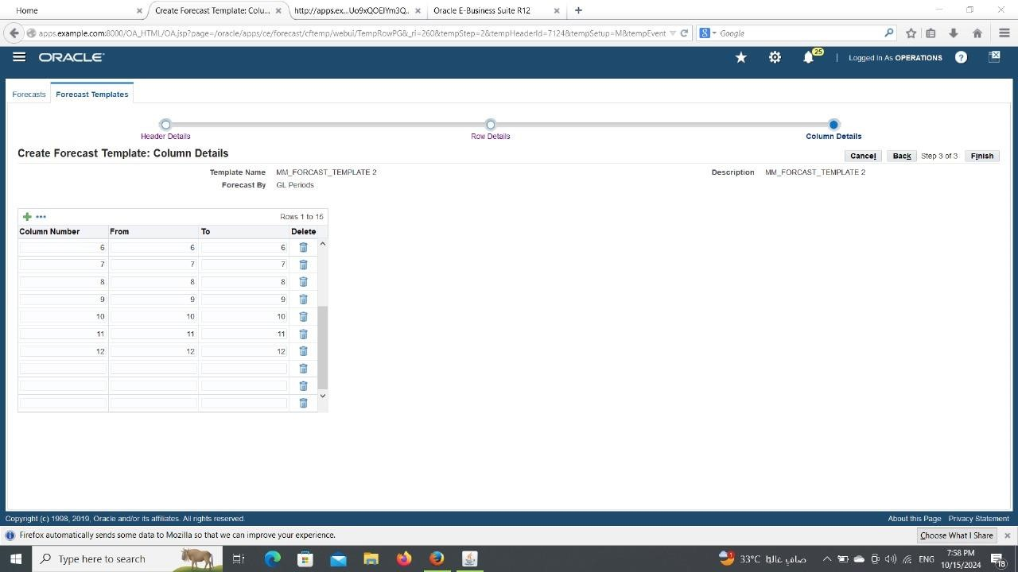
Click on Finish ‘MM_forecast_Template 2’ has been created. Close the form.

Slide 49
N: - Cash Forecasting

Slide 50

Click on View Forecasts

Slide 51
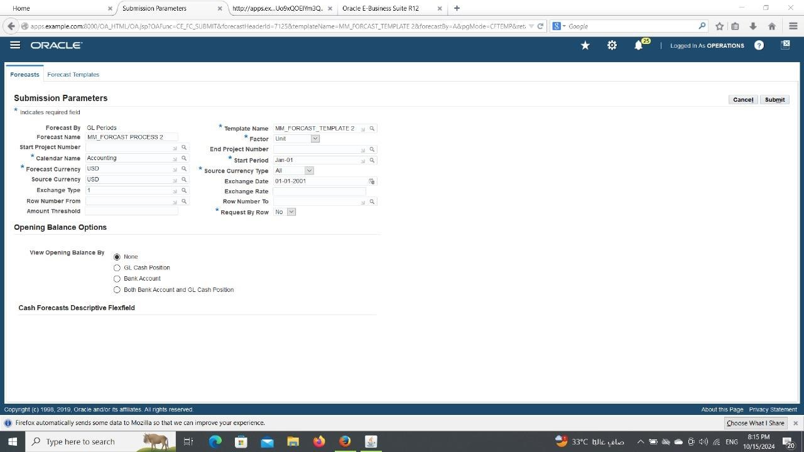
Enter the required data and Click on Submit

Slide 52
Click on Template Name- MM_forecast_Template 2

Slide 53
Click on Run Forecast

Slide 54
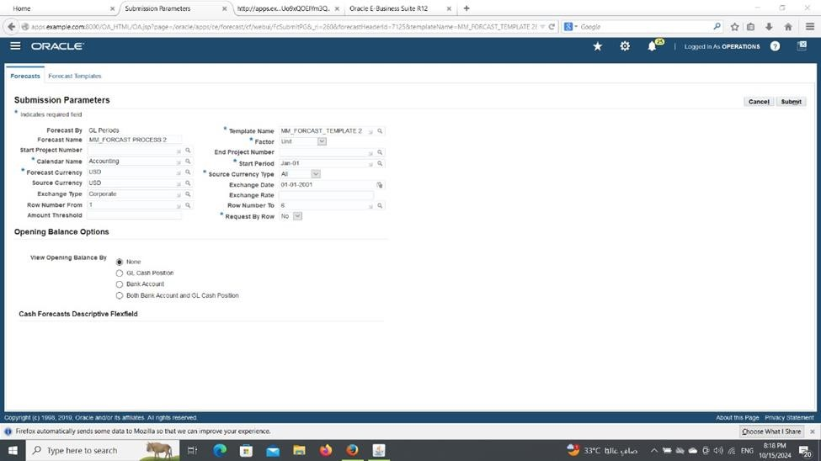
Enter the required data and Click on Submit

Slide 55
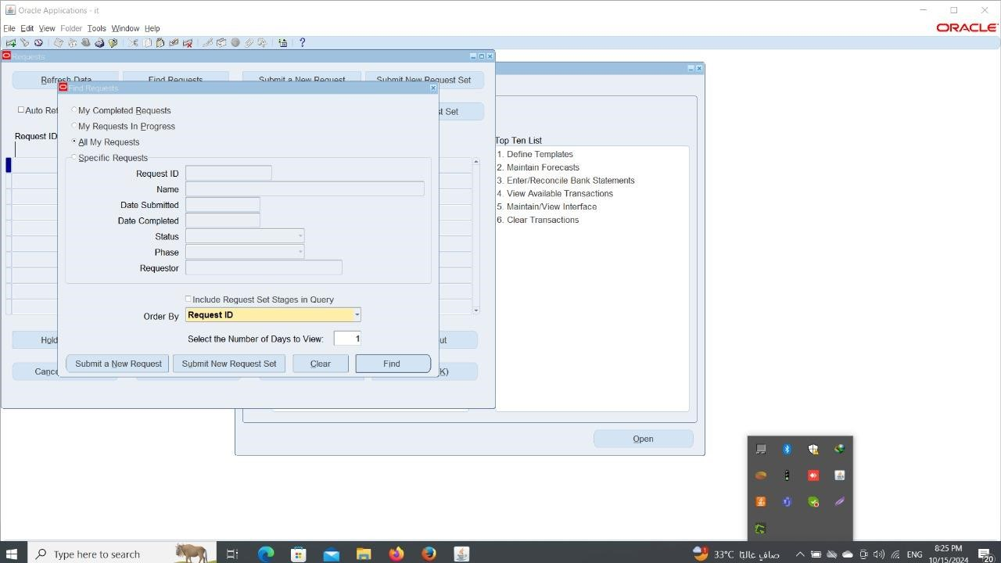
Close the form Menu-> View-> Requests

Slide 56
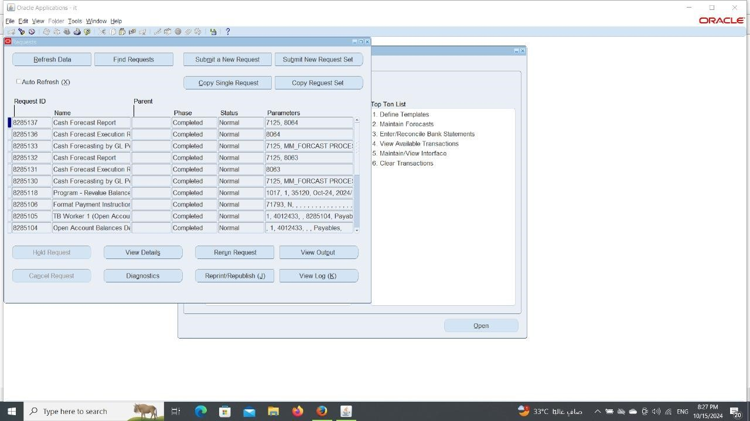
Click on Find Click on Refresh Data

Slide 57
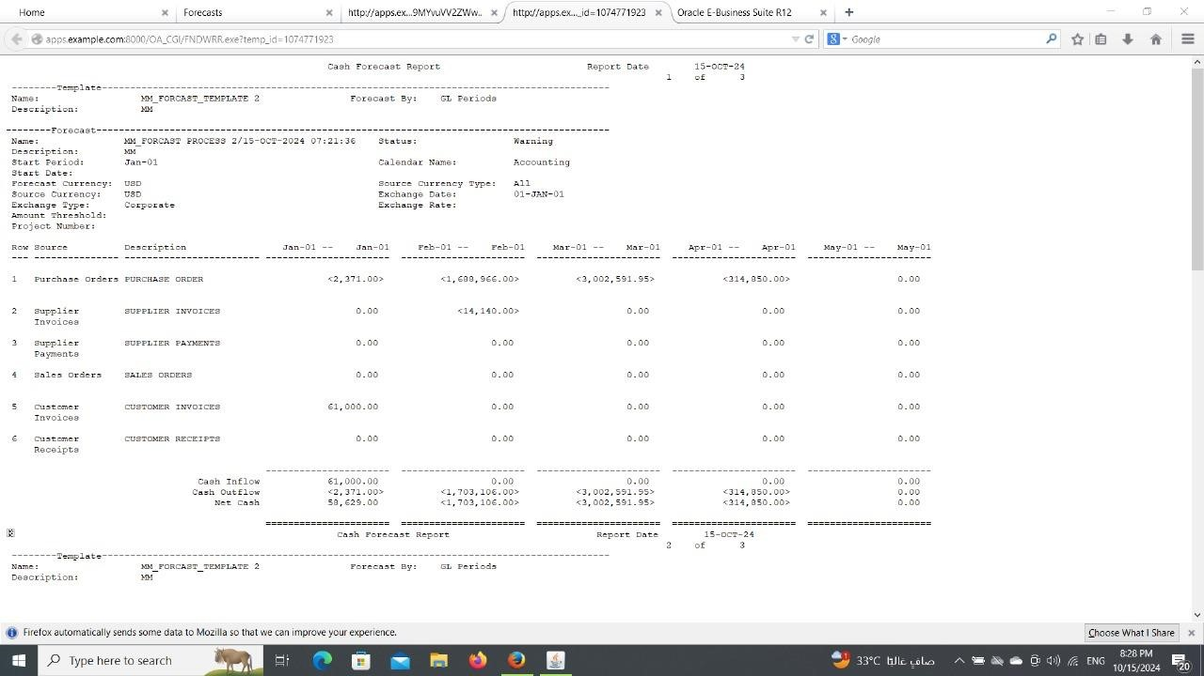
Click on View Output

Slide 58
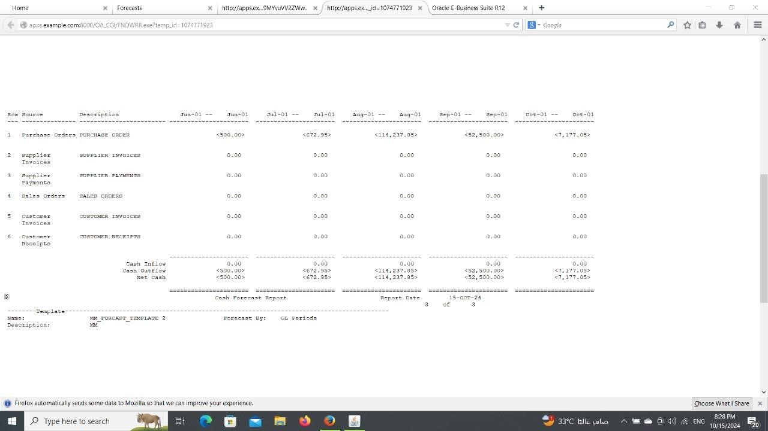

Slide 59
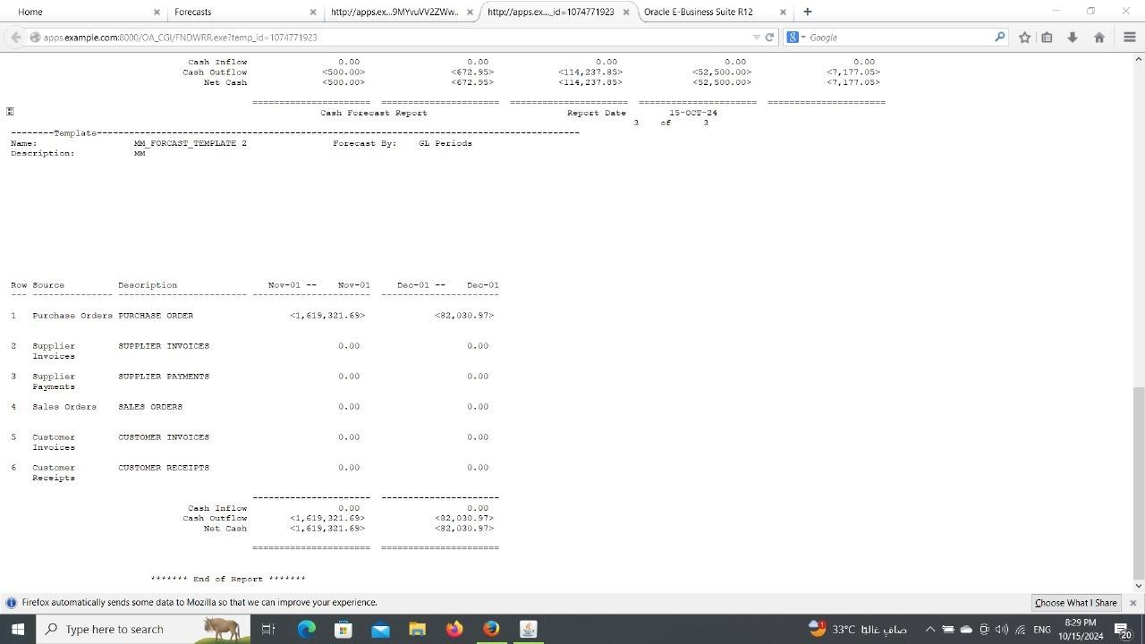

Slide 60
5. Reconcile with General Ledger
Reconcile the Cash Management sub-ledger with the General Ledger.
Ensure all cash transactions have been correctly recorded and posted.
Reconciliation with General Ledger Using Oracle ERP
Objective: Ensure that all cash transactions recorded in the Cash Management module are accurately reflected in the General Ledger, maintaining data consistency and preventing errors in financial reporting.

Slide 61
Steps
in Oracle ERP:
1. Extract Cash Transactions: Navigate to Cash Management → Reports → Cash Transactions Summary. Filter by the relevant period and type of transactions (e.g., deposits, payments).
2. Generate General Ledger Reports: Go to General Ledger → Reports → Account Analysis and extract a detailed report of cash-related accounts for the same period.
3. Identify and Analyze Discrepancies: Compare the Cash Management transactions with the General Ledger entries. Look for missing records, incorrect values, or duplicate entries.
4. Post Adjustments if Needed: If discrepancies are found, create adjustment entries through General Ledger → Journals → Create Journal Entry, ensuring each entry is documented properly.
5. Verify and Confirm: Run a Trial Balance Report to ensure both systems are now fully aligned. Outcome: All discrepancies have been resolved, and the Cash Management and General Ledger are fully synchronized.

Slide 62
6. Review and Adjust Cash Forecasting Model
Finalize adjustments to the cash forecasting model based on end-of-period results.
Create a detailed forecast for the upcoming period.
2. Cash Forecasting Review and Adjustment Using Oracle ERP Objective: Analyze previous cash forecasts, adjust the model where necessary, and create a new forecast aligned with actual financial conditions.

Slide 63
Steps
in Oracle ERP:
1. Retrieve Actual Cash Flows: Go to Cash Management → Reports → Cash Flow Statement and extract actual inflows and outflows for the current period.
2. Compare Forecast vs. Actuals: Use Cash Management → Forecasts → Compare Forecast vs. Actuals to analyze any deviations between previous forecasts and actual performance.
3. Update the Forecast Model: Adjust the forecast model by accounting for changes, such as delayed payments or unexpected expenses. Go to Forecasts → Create/Update Forecast to input new assumptions and data.
4. Generate a New Forecast for the Next Period: Create a forecast based on: Expected Revenues: From outstanding invoices. Anticipated Expenses: Including payroll, vendor payments, and operational costs. Cash Reserves and Planned Investments. Export the forecast as a report for management review.
Outcome: The new forecast aligns better with actual cash flows, improving the organization’s ability to plan ahead. Challenges and Lessons Learned

Slide 64
System Challenges: Some complex transactions required manual reconciliation, despite Oracle’s auto reconciliation tools.
Delayed Payments: Payment delays from clients affected cash flow, emphasizing the need for closer follow-up.
Unexpected Expenses: Unplanned operational costs highlighted the importance of maintaining cash reserves. Lessons Learned: Automation is Key: Leveraging Oracle’s tools more effectively will reduce manual work. Continuous Monitoring: Regularly reviewing forecasts ensures accuracy and timely adjustments. Proactive Communication: Building stronger relationships with clients and vendors minimizes delays. Recommendations
Maximize Use of Automation: Utilize Oracle’s automated reconciliation tools more effectively to save time and reduce errors.
Scenario Planning: L Use the forecasting tool to simulate different scenarios (e.g., best-case and worst case) for better preparedness.
Ongoing Training: Regularly train the finance team on Oracle ERP’s features to keep them updated on best practices.

Slide 65

Thank you for your attention. If there are any questions, We would be happy to answer them

